Slide 1
The key principles of pharmacology

Slide 2
Introduction (1)
Pharmacodynamics is the study of the effect of medicine on the body; scientists ask questions like:
  What does the medicine do to the body?
  What receptors does the medicine activate?
  What other effects does the medicine have?
Notes:
Medicines work in two main ways:
By changing the cell environment, e.g. antacids: neutralize stomach acidity
By binding to receptors on cell membranes and alter cellular function, e.g. digoxin: binds to receptors on heart cells and improves cardiac contractility
The interaction of a medicine with its receptor is similar to a Lock-and-Key mechanism: the medicine interacts with the cell receptors, with one of two effects:
Agonist: the medicine binds and stimulates a specific receptor, producing a physiological effect:
norepinephrine stimulates receptors on the heart cells increasing heart rate
Antagonist: the medicine binds to a specific receptor and blocks other substances from stimulating the receptor:
the antihistaminic diphenhydramine blocks histamine receptors and prevents allergic reactions

Slide 3
Introduction (2)
Pharmacokinetics (PK) is the study of the effect the body has on medicines; scientists ask questions like:
  How does the medicine get into the body?
  Where does the medicine go?
  What does the body do to the medicine?
  How does the body get rid of the medicine?
Notes:
PK data evaluates how the body handles a medicine. Such data is essential for determining dosing regimens. The combination of science and mathematical models aid the prediction and understanding of the time-course of medicines (and their metabolites) in the body.
Many pharmacokinetic studies are carried out in animals (toxicokinetics).

Slide 4
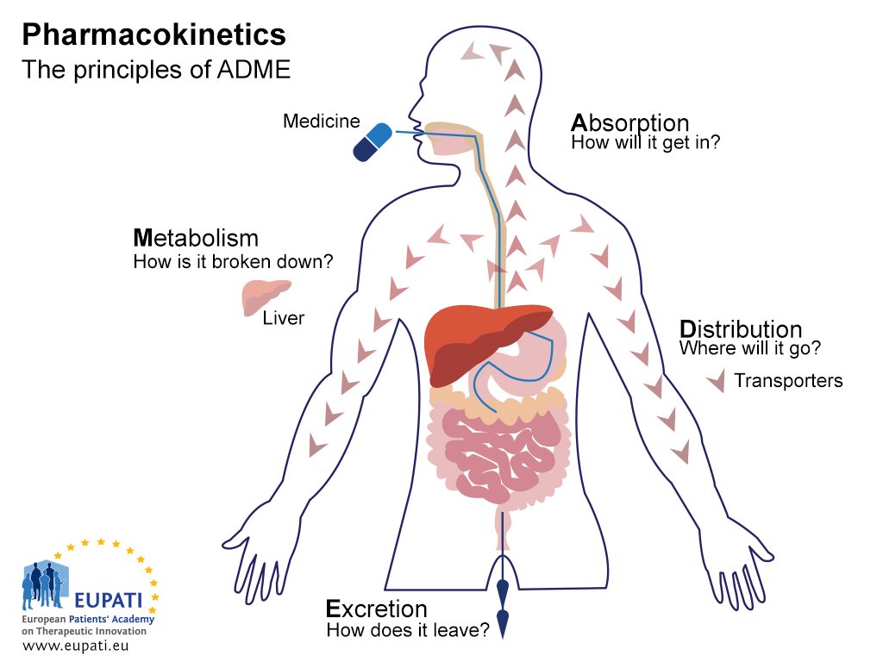
Notes:
Non-clinical studies investigate the safety profile of a new medicine, and also provide important information to help researchers decide if the candidate compound can proceed into the first human (clinical) study and if so, what doses to use. The pharmacokinetics acronym you will find in every text book associated with pharmacology is ADME
Absorption = how the medicine gets in to the body
Distribution = where the medicine goes in the body
Metabolism = How the body chemically modifies the medicine
Excretion = how the body eliminates the medicine
The above four elements we need to consider when talking about the pharmacology of a certain medicine in animals and in humans. More importantly, together, they will provide data indicating the difference between beneficial and negative (toxic) effects. These ADME elements mainly help to predict the safety/tolerability of an investigational compound in humans.

Slide 5
Principles of toxicokinetics
Defined as the generation of PK data in animals.
Describes the systemic exposure achieved in animals and its relationship to dose level and the time course of the toxicity study.
Primary focus on the interpretation of toxicity tests.
No rigid detailed procedures for the application of toxicokinetics are generally recommended.
The need for toxicokinetic data based on a flexible step-by-step approach.
Notes:
Toxicokinetics is defined as the generation of pharmacokinetic data, either as:
an integral component in the conduct of non-clinical toxicity studies or
in the interpretation of toxicology findings and their relevance to clinical safety issues.
The primary objective is to describe the systemic exposure achieved in animals and its relationship to dose level and the time course of the toxicity study.
Due to its integration into toxicity testing and its bridging character between nonclinical and clinical studies, the focus is primarily on the interpretation of toxicity tests and not on characterising the basic pharmacokinetic parameters of the substance studied.
As the development of a pharmaceutical product is a dynamic process which involves continuous feed-back between non-clinical and clinical studies, no rigid detailed procedures for the application of toxicokinetics are generally recommended, and therefore it may not be necessary for toxicokinetic data to be collected in all studies and scientific judgment should dictate when such data may be useful.
The need for toxicokinetic data and the extent of exposure assessment in individual toxicity studies should be based on a flexible step-by-step approach and a case-by-case decision making process to provide sufficient information for a risk and safety assessment.

Slide 6
Absorption (1)
Understanding the processes that control absorption are critical for developing active medicines.
Absorption refers to how medicines enter the blood stream. There are several routes of administration.
The image on the next slide compares oral and intravenous administration in terms of their bioavailability – that is, how quickly after administration the active pharmaceutical ingredient becomes biologically available
Notes:
Absorption
It refers to how medicines enter the bloodstream. There are several routes of administration:
1. Oral administration (PO: per os – by mouth) is a route of administration where a substance is taken through the mouth.
80% of medicines used in medical practice are given orally
route is convenient and economical
medicine is ingested
absorbed from the stomach / intestine
enters hepatic portal circulation: enters liver
enters general circulation
2. Sublingual (SL)
medicine is dissolved under the tongue and is absorbed through mucous membranes into the bloodstream
route is convenient and economical
example: sublingual tablets
3. Transdermal (TD)
medicine contained in a patch is absorbed through the skin
advantage: medicine dosage is continuous and long-acting
disadvantage: product is expensive and may cause local irritation due to the adhesive component
example: nicotine, oestrogen patches
4. Rectal (PR)
medicine (in suppository form) is inserted into the rectum where is absorbed through mucosa into the bloodstream
advantage: used for unconscious or vomiting patients
disadvantage: medicine may be incompletely or irregularly absorbed
examples: analgesic and anti-nauseant suppositories
5. Inhalation
medicine is inhaled as a gas, aerosol or mist
route is usually intended to allow medicine to act directly on lung tissue
advantage: inhaled medicine produces a rapid onset of action
disadvantage: inhaled medicine may irritate lung tissue
examples: bronchodilator mist
6. Intranasal
medicine is absorbed through the mucosa membranes in the nose into the bloodstream
examples: anti-congestion nasal spray
7. Parenteral (intravenous - IV, intramuscular - IM, subcutaneous - SQ)
advantages:
produces a faster response than oral or rectal routes
avoids unpredictable absorption through gastrointestinal system
useful in unconscious patients
disadvantages:
requires sterile conditions to prevent infections
more costly than other routes of administration
pain at the injection site

Slide 7
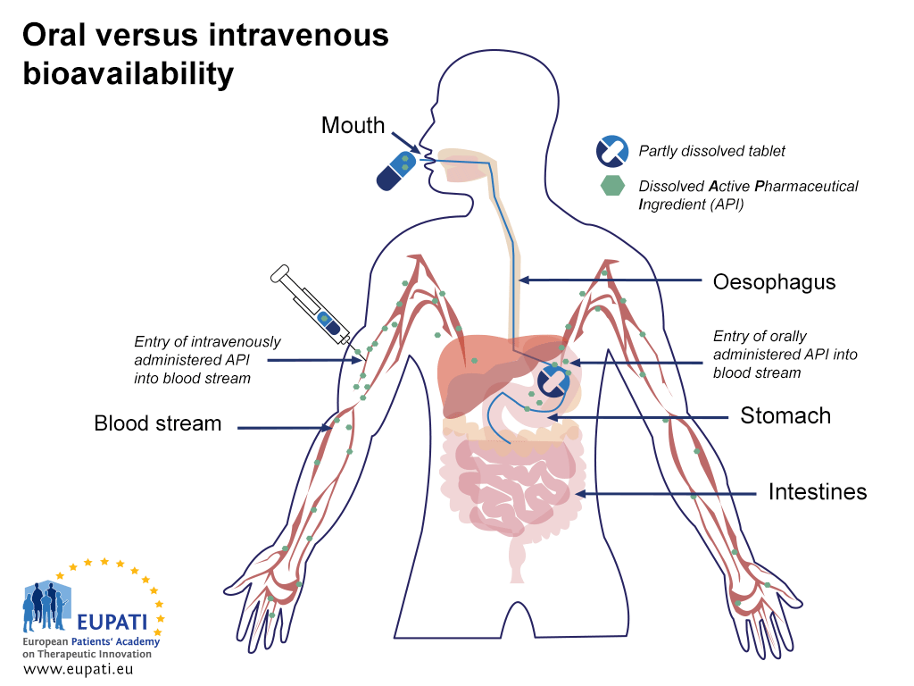
Notes:
Medicine is absorbed (enters the blood stream and becomes bioavailable) differently by the body depending on how it is administered. The image compares the absorption of medicine administered intravenously with that administered orally. Orally administered medicine must be digested before the active pharmaceutical ingredient (API) enters the bloodstream (is absorbed); the API of an intravenously administered medicine enters the bloodstream immediately.

Slide 8
Distribution (1)
Medicines can enter the body in many different ways, and they are absorbed when they travel from the site of administration into the body's circulation.
Distribution refers to how medicines are distributed throughout the body. The degree of distribution of a medicine depends on its physical and chemical properties.
Notes:
B) Distribution
Distribution refers to how medicines are distributed throughout the body and reach their intended target. The degree of medicine distribution depends on its physical and chemical properties and its ability to penetrate cell membranes, blood vessels, the blood-brain barrier, etc.
Blood-Brain Barrier (BBB)
Only fat-soluble medicines and very small molecules are able to penetrate the tight cell connections which separate the circulating blood from the brain (the blood-brain barrier, BBB) to have a pharmacologic effect
Example: heroin has a greater effect on the brain than morphine because of its greater fat-solubility
Plasma Protein Binding
Many medicines bind reversibly with plasma proteins such as albumin, so the protein-medicine binding profile determines distribution and elimination rate. Only unbound or ‘free’ medicines may:
diffuse through capillary walls
produce a pharmacologic effect
be metabolised and excreted

Slide 9
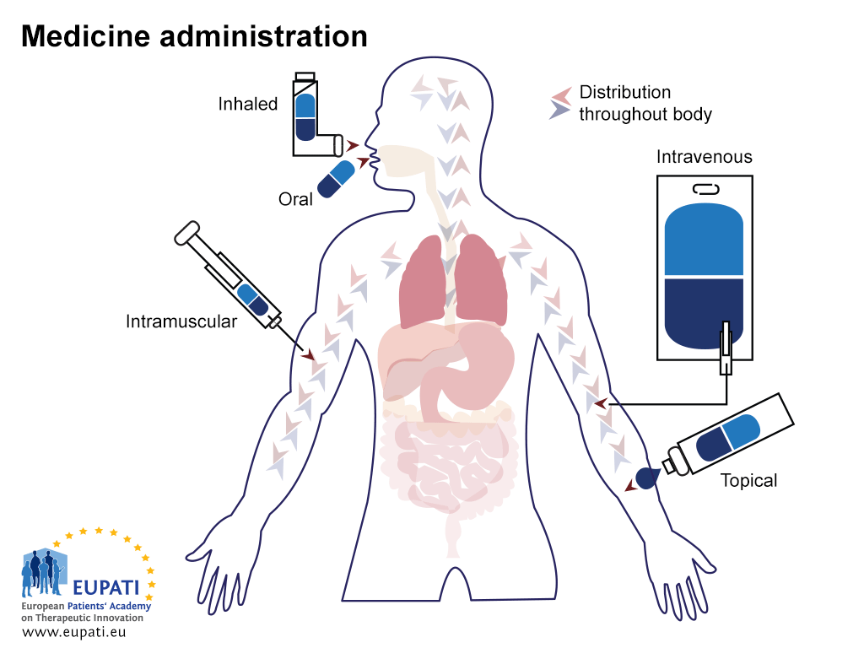
Notes:
After medicine has been administered, it is distributed throughout the body to reach its final target.

Slide 10
Distribution (2)
A few of the most common ways to administer medicines are:
  oral (swallowing a tablet),
  intramuscular (injection into a muscle, i.e., arm),
  subcutaneous (injection just under the skin),
  intravenous (receiving drug into a vein),
  or transdermal (wearing a skin patch).
The medicine must reach its intended target.

Slide 11
Metabolism (1)
The majority of medicines are chemically active and are metabolised in the body.
This has many consequences, such as:
  a loss of activity
  an increase in activity
  a reduction in toxicity
  an increase in toxicity
Notes:
C) Metabolism (Medicine Biotransformation)
Metabolism is the enzymatic conversion of one chemical compound into another. Most metabolism of medicine occurs in the liver (shown in the middle of the diagram), although some processes occur in the gut wall, lungs, and blood plasma. On the whole, as drugs are metabolised their therapeutic effect changes.
The complex liver enzyme system converts fat-soluble medicines to water-soluble metabolites which can then be eliminated by the kidneys.
“First-Pass Effect” (Liver)
substances (medicines, toxins, foods, etc.) absorbed into the bloodstream from the GI tract, enter the liver via the hepatic portal vein before entering the general circulation.
the “first-pass effect” allows the liver to metabolise or deactivate medicines and potentially harmful substances before they are distributed throughout the body.
medicines are converted into less active or inactive metabolites by the liver.
The chief functional cells of the liver (known as hepatocytes) contain all the necessary enzymes for the metabolism of medicines. Enzymes are proteins that control the speed of chemical reactions in your body. The main enzymes involved in metabolism belong to the cytochrome P450 group.
Phase 1 metabolism can involve reduction or hydrolysis of the drug, but the most common biochemical process that occurs is oxidation. Oxidation is the chemical reaction that occurs for example when apples turn brown when exposed to the oxygen in air.
Oxidation is catalysed by cytochrome P450 enzymes and results in the loss of electrons from the drug (electrons are negatively charged subatomic particles).
The medicine is now said to be oxidised. After phase 1 reactions, the resulting medicine metabolite is often still chemically active. A metabolite is any substance produced during metabolism. They can be polar and non-polar molecules (or species).
Phase 2 metabolism involves conjugation - that is, the attachment of an ionised group to the medicine. The attachment of an ionised group makes the metabolite more water soluble. This facilitates excretion (described as elimination in the diagram) and decreases pharmacological activity.
Renal elimination (via the kidneys as urine)
Biliary elimination (via the gut as faeces/stool)
Some drug metabolites can be toxic, such as those produced from paracetamol. These are detoxified by Phase 2 conjugation joining with glutathione. Glutathione is the body’s most powerful antioxidant. It is found inside every single cell in your body.
However, in an overdose situation where the dose of paracetamol is high, there is not enough glutathione to detoxify the metabolites. They accumulate and cause toxicity; this can result in hepatitis. As a solution, compounds are made to boost the levels of glutathione so that Phase 2 metabolism can take place, thus detoxifying the paracetamol metabolites fully and reducing the risk of liver injury.
University of Nottingham. RLO: The Liver and Drug Metabolism. Retrieved 28.9.205 from http://www.nottingham.ac.uk/nmp/sonet/rlos/bioproc/liverdrug/index.html

Slide 12
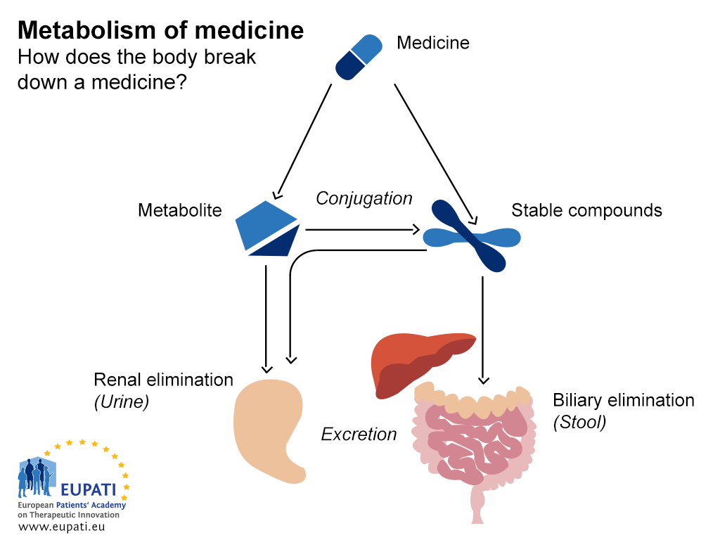

Slide 13
Excretion
There are a number of routes of excretion for medicines and metabolites. In order of importance, these are:
Renal (kidneys)
In faeces
Expired air (lungs)
Through sweat (skin)
Minor routes include:
saliva
breast milk
Notes:
D) Excretion
Excretion refers to how the body gets rid of a medicine or its metabolites. There are three main routes of elimination: kidneys, liver, and bowel. Most medicines are excreted as active, partially active, or inactive metabolites by the kidneys.
1) Excretion by kidneys after medicine metabolism:
The liver transforms medicines into compounds which are more readily excreted by kidneys
Excretion by kidneys directly into the urine
2) Excretion in faeces
Entero-hepatic recirculation: metabolised medicine is secreted by the liver in bile and enters small intestine where it is reabsorbed into the bloodstream from small intestine and returned to the liver or eliminated in faeces
Medicine excretion and age considerations:
infants have underdeveloped abilities to metabolise and excrete medicines which usually results in greater sensitivity
elderly have impaired ability to metabolise and excrete medicines resulting in greater sensitivity

Slide 14
The non-clinical phase
In vitro (animal)
In vitro (human)
In vivo pharmacokinetics (animal)
Predictions for first-in-human use
In vivo pharmacokinetics / pharmacodynamics (animal)
This diagram describes what researchers try to achieve during the non-clinical phase of medicines discovery.

Slide 15
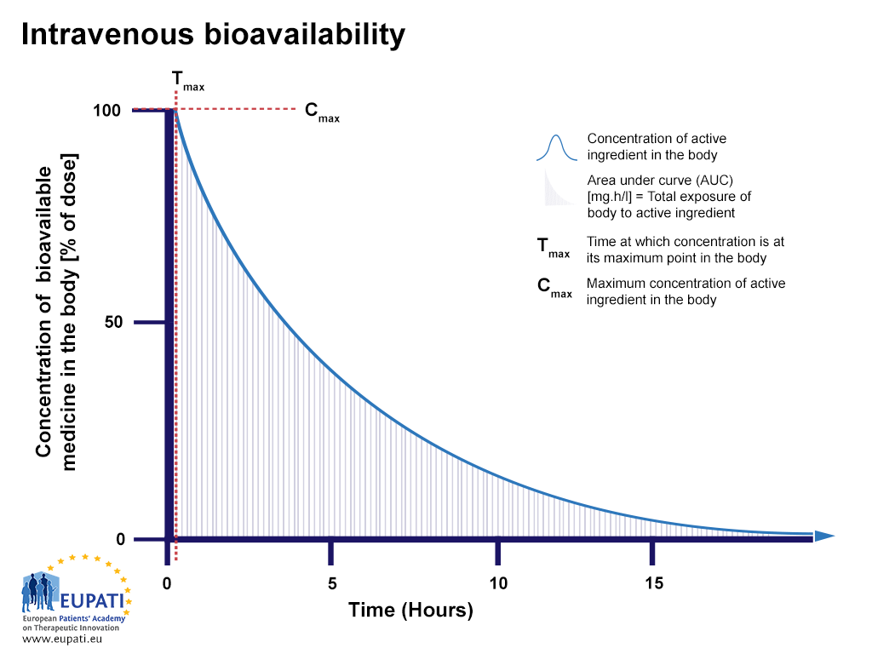
Measuring pharmacokinetics
Notes:
Measuring pharmacokinetics
First, the speed with which the medicine appears in the bloodstream after administration is measured (absorption and distribution).
The, the speed with which the medicine leaves the body (excretion) and how it changes over time (metabolism – converting the medicine into metabolites and even second metabolites) is measured.
The diagram above is an example of the bioavailability profile of an intravenously administered medicine.
The diagram shows important aspects of pharmacokinetics and pharmacology:
Y axis – concentration of medicine within the body.
X axis – time.
If we give a person a medicine at time zero, we will see the concentration of the medicine increase and then slowly decrease as the medicine is eliminated from the body.
The bioavailability profile of the medicine is evaluated and compared to other medicines by looking at the area under the curve (AUC), which represents the total exposure to an active substance that the body receives.

Slide 16
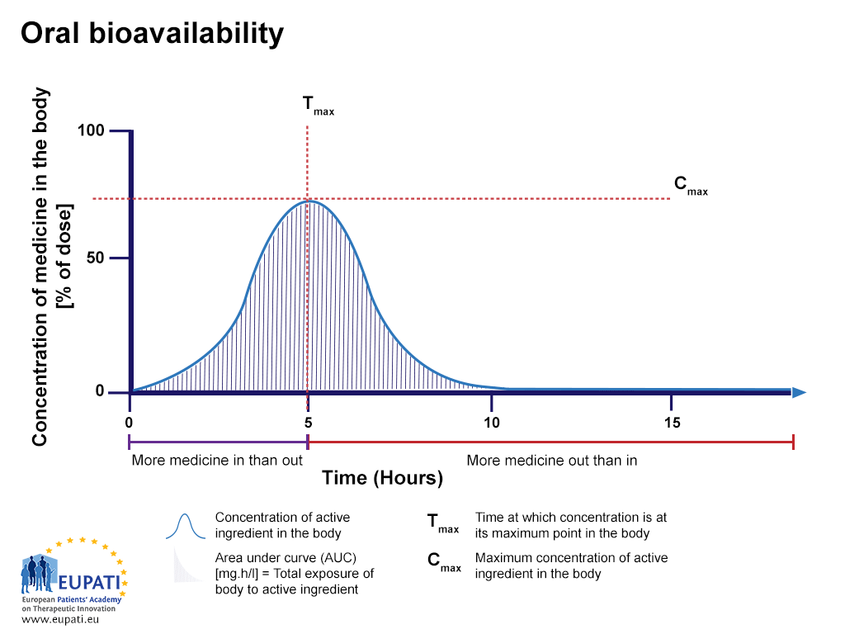
Notes:
The medicine enters the body faster than it is being removed, therefore the concentration of the medicine in the body increases.
Then after the peak of this graph the medicine is eliminated from the body faster than it is entering, so the concentration of the medicine in the body starts decreasing.
The dashed red line is important. This is the highest concentration of medicine in the body, therefore termed maximum concentration or Cmax.
Knowing the maximum concentration can help predict the benefit and also the likelihood of side effects
The time at which the maximum concentration occurs is called Tmax.
The bioavailability profile of the medicine is evaluated and compared to other medicines by looking at the area under the curve (AUC), which represents the total exposure to an active substance that the body receives.

Slide 17
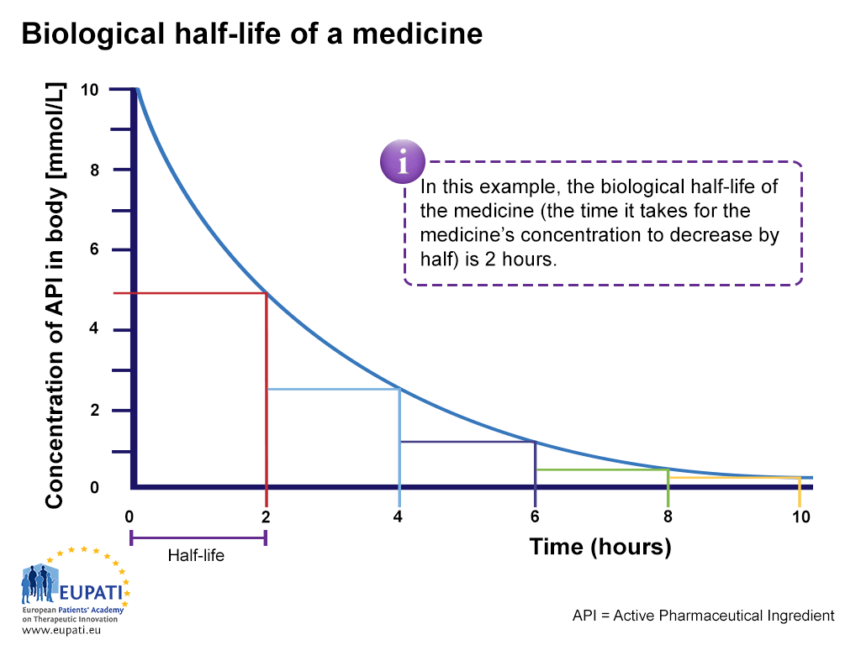
Notes:
Another concept is the half life of a medicine which is by definition the time it takes to remove half the current concentration of the medicine from the body.
From Tmax (in this example, 0) we want to see how much time it takes for the concentration of the medicine to decrease from Cmax (in this example, 10) to half of Cmax (in this example, 5). The time it takes the medicine to drop from its maximum level to half of its maximum level is its half-life, as shown above by the purple line.
The area under the curve shows the total exposure to a medicine that the body receives. This the function of how high the concentration of the medicine goes and how quickly it is excreted.
The bioavailability profile of the medicine is evaluated and compared to other medicines by looking at the area under the curve (AUC), which represents the total exposure to an active substance that the body receives.

Slide 18
Medicines and ADME
A lead compound is not a medicine.
It is usually the most potent agent discovered.
In order for a lead compound to become an effective medicine, its pharmacological profile (including ADME factors), toxicological profile, efficacy, and safety must all be satisfactory.

Slide 19
The starting dose for clinical development (1)
A safe starting ‘First-in-human’ dose should be driven by data from animal pharmacology and toxicology studies in different animal species before the trials are begun in humans.
From toxicology data, the first concern is to select a starting dose that would cause the desired effect without inducing a negative (toxic) response.
From pharmacological data, it is necessary to understand the mechanism of action, concentration-response, and other aspects of the pharmacokinetic (PK) and pharmacodynamic (PD) profile.

Slide 20
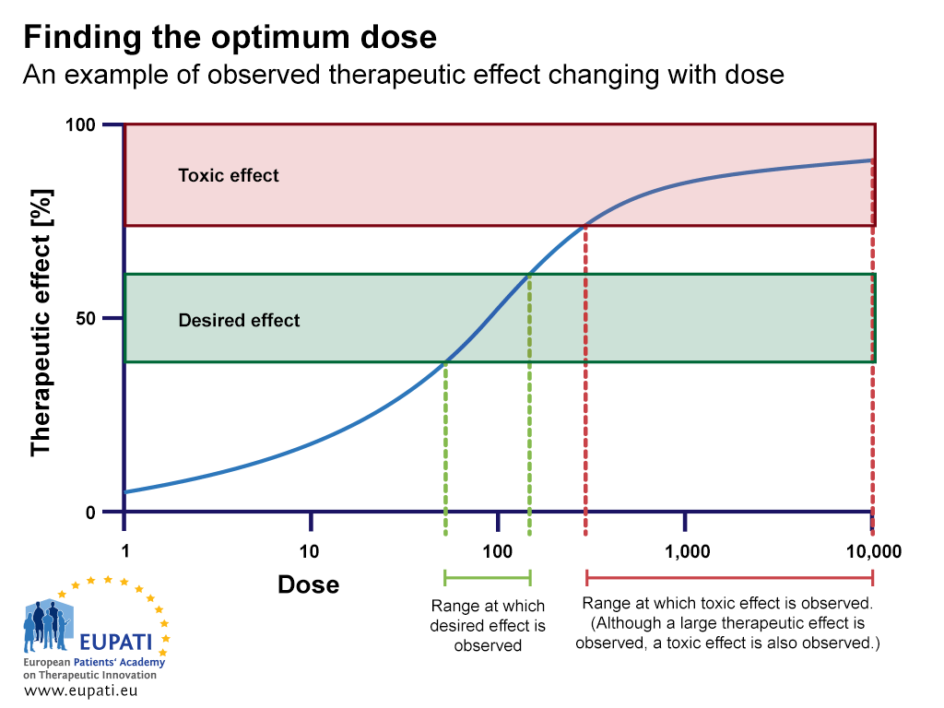

Slide 21
Further reading:
Guideline on Strategies to Identify and Mitigate Risks in First-in-Human Clinical Trials with investigational Medicinal Products http://www.ema.europa.eu/docs/en_GB/document_library/Scientific_guideline/2009/09/WC500002988.pdf
Non-Clinical Safety Studies for the Conduct of Human Clinical Trials for Pharmaceuticals http://www.ema.europa.eu/docs/en_GB/document_library/Scientific_guideline/2009/09/WC500002941.pdf
Preclinical safety evaluation of biotechnology-derived pharmaceuticals http://www.ema.europa.eu/docs/en_GB/document_library/Scientific_guideline/2009/09/WC500002828.pdf
The Non-Clinical Evaluation of the Potential for delayed Ventricular Repolarisation (QT Interval Prolongation) by Human Pharmaceuticals http://www.gpo.gov/fdsys/pkg/FR-2005-10-20/pdf/05-20959.pdf
Notes:
Recommended video: http://www.youtube.com/watch?v=mp93nPUzHqM&list=TLMdfpSMe8pGyVo0neC5BiZQ1xH6BQtidy

Slide 22
Further reading:
Safety pharmacology studies for human pharmaceuticals http://www.ema.europa.eu/docs/en_GB/document_library/Scientific_guideline/2009/09/WC500002831.pdf
Toxicokinetics: the assessment of systemic exposure in toxicology studies http://www.ema.europa.eu/docs/en_GB/document_library/Scientific_guideline/2009/09/WC500002770.pdf
Position paper on the non-clinical safety studies to support clinical trials with a single micro dose http://www.ema.europa.eu/docs/en_GB/document_library/Scientific_guideline/2009/09/WC500002720.pdf
Pharmacodynamics and Pharmacokinetics made ridiculously simple. Ezra Levy: http://www.bibliopedant.com/zWTroRYXFIinuD4DaLB7
Estimating the Maximum Safe Starting Dose in Initial Clinical Trials for Therapeutics in Adult Healthy Volunteers http://www.fda.gov/downloads/Drugs/Guidances/UCM078932.pdf

